Slide 1

Customer Analysis
“Happy Customers, happy US”
Presented by Team S:
Haoming Wang,
Xuetian Xie,
Shuo Yu,
Shuoxin Yu

Slide 2

Business opportunity
It is important for business to understand their customer, making it easier for them to promote their products to target customers in an appreciate strategies, based on demographic and purchasing information
Business Objective:
Target different type of customers using different marketing strategies
How does customer traits and purchasing information related to the product they purchase
Why?
Lower Customer Acquisition Costs
Better Customer Retention
More Effective Customer Service
Increased Sales and Profits

Slide 3




Data Collection
Data Preprocessing
Recency Frequency Monetary
Existing Customer
Content
Future Customer Behavior Prediction
Customer Action Prediction
Model Interpretation
Recency Frequency Monetary
Association Rule Analysis
Future Client Recommendation
Marketing
Client Actions

Slide 4

Data description
Data Source: Kaggle
About Dataset:
2240 rows, 29 columns
Contains information about:
Customer demographic(e.g. Year birth, education, marital status…)
Customer activities (e.g. Number of days since customer's last purchase, Complain…)
Amount spent in different products(Wine, fruit, meat, sweet, gold)
Promotion activities (e.g. Whether accept offer in the last campaign or not)
Number of purchase made in different sells channel(Web, Catalogue, Store)

Slide 5
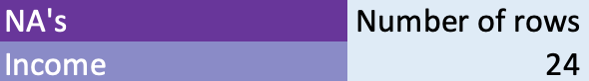
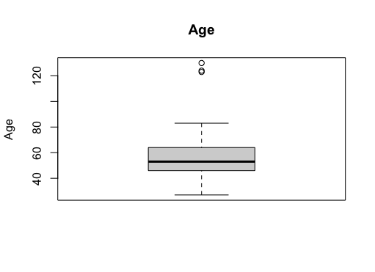
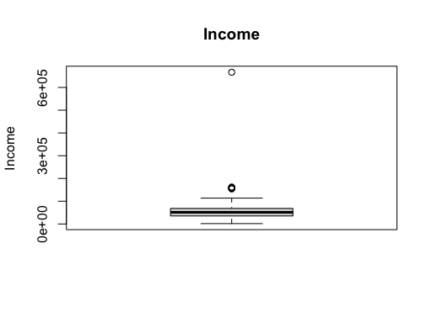
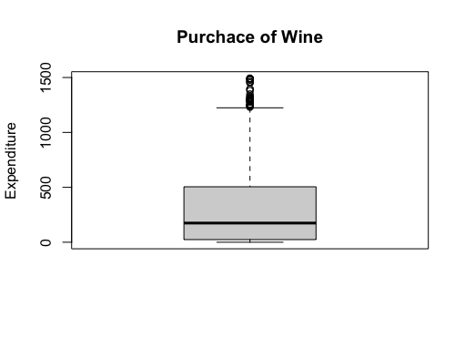
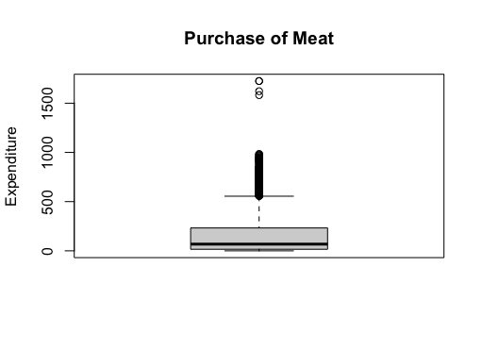
Data Cleaning & preprocessing
Dropping NaNs
Column Transformation:
Date of Birth -> Age; Dt_Customer -> VIP_Days
Outliers: lower limit = 15% percentile - 1.5IQR
upper limit = 85% percentile + 1.5IQR
Dropping duplicated Columns: Z_CostContrast, Z_Revenue
Results:
2240 rows * 29 cols -> 1977 rows * 27 cols

Slide 6
Existing Customers and Future Customer behavior ANAlysis

Slide 7
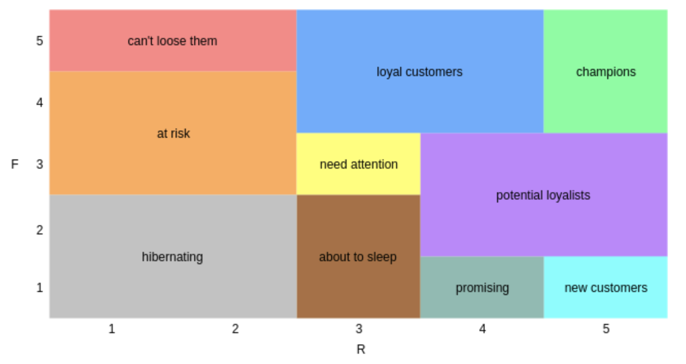
rfm Reference
Segment | Description
Champions | Bought Recently, buy often and spend the most.
Loyal Customers | Buy on a regular basis. Responsive to promotions.
Potential Loyalist | Recent customers with average frequency.
New Customers | Bought most recently, but not often.
Promising | Recent shoppers, but haven’t spent much.
Need Attention | Above average recency, frequency and monetary values. May not have bought very recent though.
About To Sleep | Below average recency and frequency. Will lose them if not reactivated.
At Risk | Purchased often but a long time ago. Need to bring them back!
Cannot Lose Them | Used to purchase frequently but haven’t returned for a long time.
Hibernating | Last purchase was long back and low number of orders. May be lost.
Notes:
Reference: https://www.kaggle.com/code/duyaryigit/rfm-segmentation-and-cltv-prediction

Slide 8
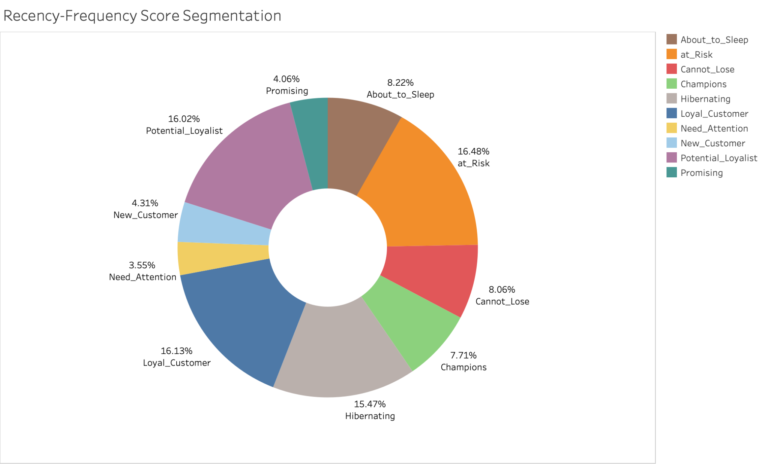
RFM ANALYSIS
Based on the RFM analysis, we recommend our clients take specific actions for each group of customers:
For solid loyal customers
Build personalized communication;
Provide exceptional customer service;
For potential loyalists
implement a follow-up and nurturing strategy to maintain engagement;
establish trust and credibility.
……

Slide 9
Future Customer Behavior PREDICTION

Slide 10
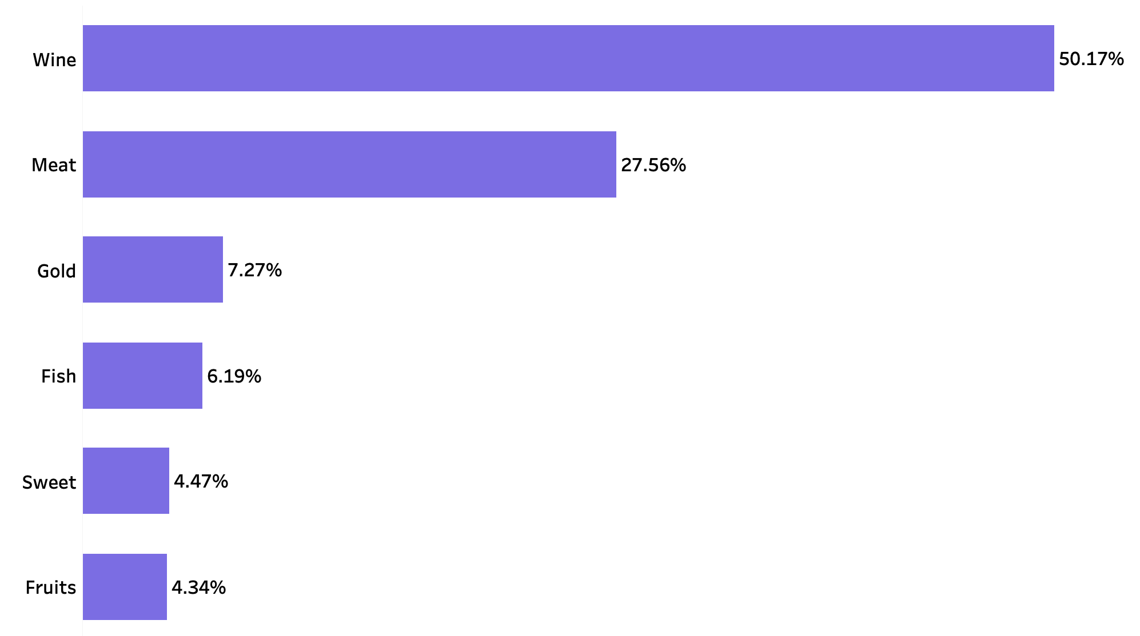
Starting Point
Customer are more likely to spend on Wine
The percentage of amount spent on wine is much higher compared to other products on all of the customer purchase.
Therefore, we are more motivated to analyze customers starting from this initial approach.

Slide 11
Performance Evaluation
01
Random Forest
Accuracy: 0.8223
AUC: 0.772
Selecting the best model based on their Test accuracy and AUC score.
Random Forest has the best prediction performance.
Logistic regression output provides how the dependent variable would change based on the independent variable coefficients.
Regression Tree provides decision based on the splits.
Naive Bayes provide conditional probabilities.
02
Logistic Regression
Accuracy: 0.8071
AUC: 0.758
03
Regression Tree
Accuracy: 0.7893
AUC: 0.739
04
Naive Bayes
Accuracy: 0.7513
AUC: 0.736

Slide 12
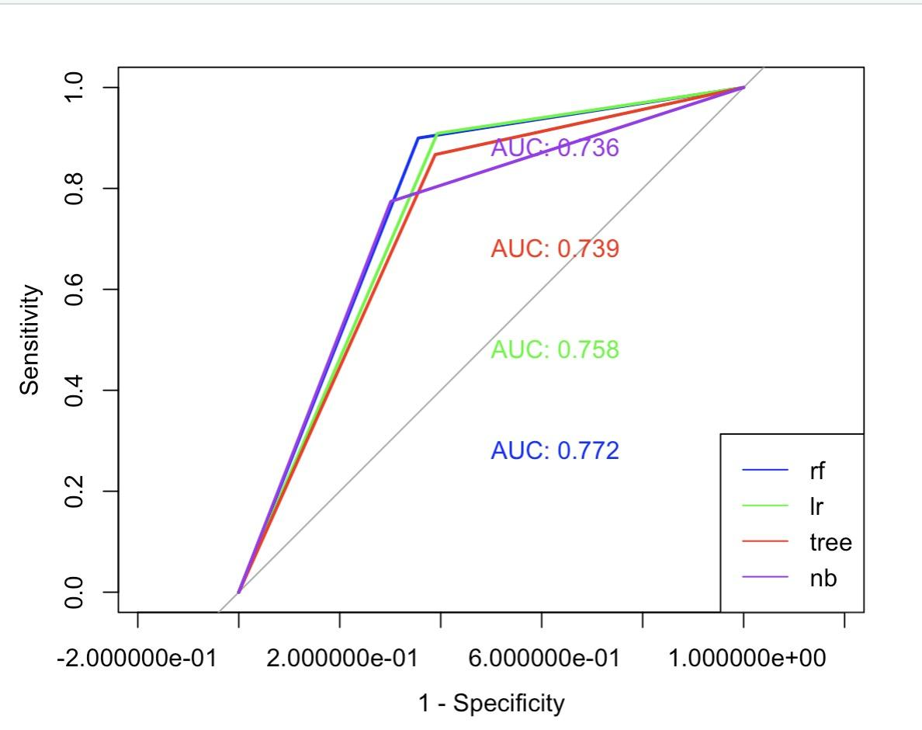
Performance Evaluation

Slide 13
From NUmbers to the Real World Application
“Does our client understand these numbers?”
“What we can tell them?”

Slide 14
Random forest
 |  | Predicted
 |  | No | Yes
Actual | No | 154 | 85
 | Yes | 55 | 494
We will used Random Forest Classification method to predict potential targeted customer for different kind of promotion.
The test accuracy provides us a percentage of chance that our prediction is correct or not.
For example, if we need to predict 1000 customers, and find out whether they are more likely to spend the max on wine, we will be able to 822 customers correctly.

Slide 15
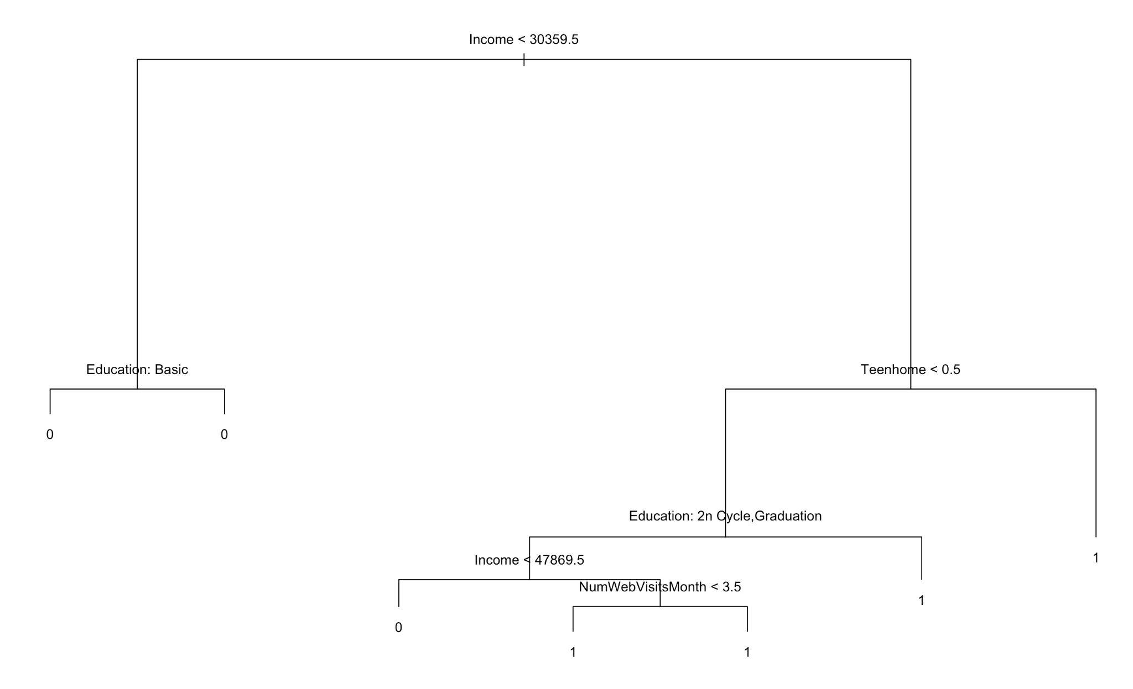
Regression Tree
Customers with annual Income less than $30359.5 are less likely to spent most on wine.
For Customers with annual income greater than $30359.5:
Those have teenagers at home are more likely to buy wine
Those don’t have teenagers at home, with education level of basic, master or PhD are more likely to buy wine
For Customers with annual income greater than $30359.5, no teenagers at home, education level of 2n cycle and graduation:
Those annual income less than $47869.5 are less likely to buy wine
Those annual income greater than $47869.5 are more likely to buy wine

Slide 16
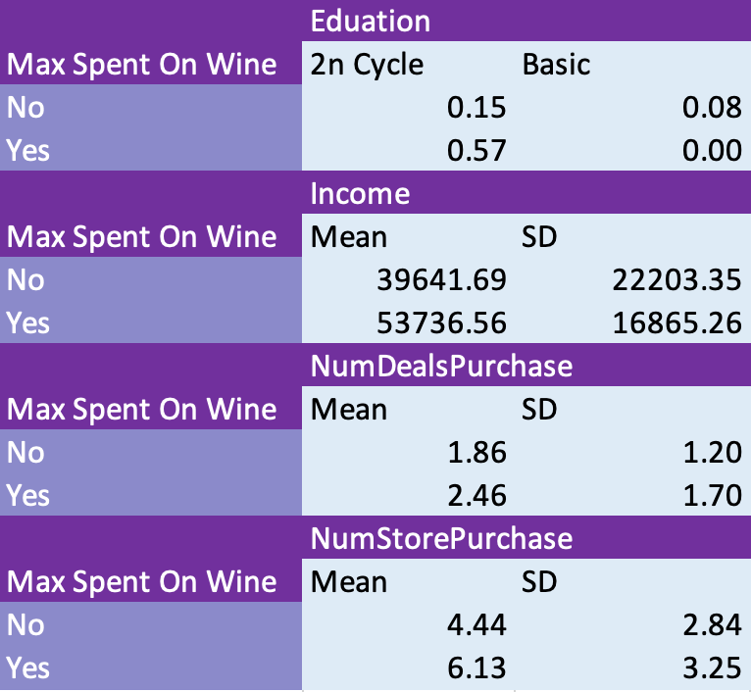
Naive Bayes
Among all the customer whose education background is 2n cycle, they are more likely to spend the max on wine, by comparing 0.15 and 0.57.
Probability of education background is basic and spend max on wine is 0 because in our train dataset, all the customer who has basic education will not spend max on wine.
Customer who is like to spend max on wine are those customers who has a mean income of $53,736 compared to a mean income of $39,641.
The mean number of deals purchase for customers who is more like to spend max on wine is higher than those not.
There is a clearly difference between the amount number of store purchase for customer who spent max on wine or not, which is making sense because based on common knowledge people tend to purchase wine in store more than online.

Slide 17
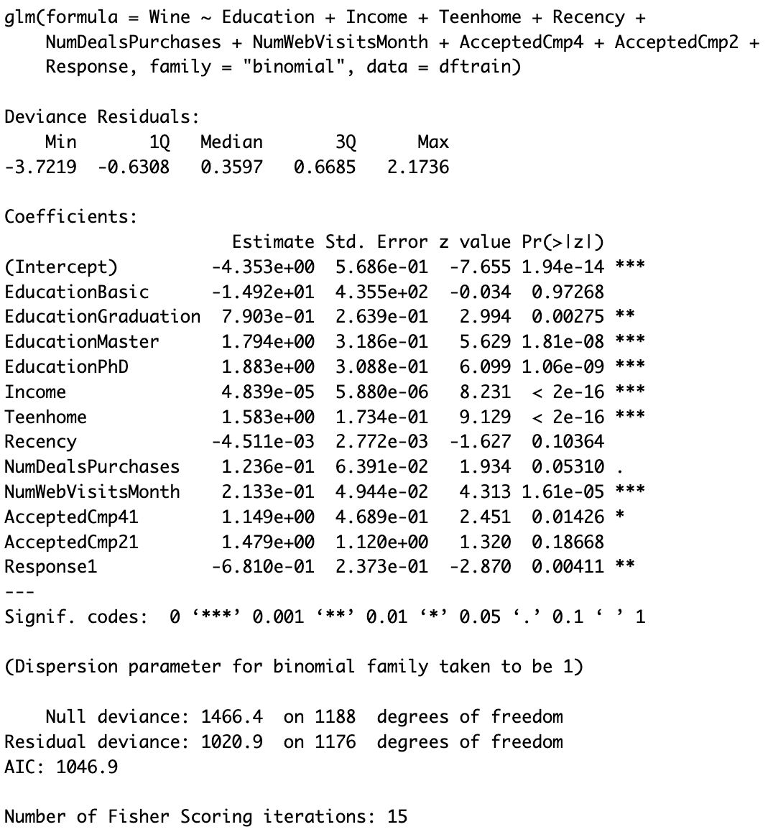
Logistic Regression
A one dollar increase in income increases the odds of spending most on wine by a factor of 1.000047
A one increase in the number of teenagers at home increases the odds of spending most on wine by a factor of 4.8694
A one day increase in the number of days since last purchase decreases the odds of spending most on wine by a factor of 0.9955
A one unit increase in the number of purchases with discount increases the odds of spending most on wine by a factor of 1.1316
A one unit increase in number of website visits last month increases the odds of spending most on wine by a factor of 1.2378
The odds of customers who accepted offers in the last campaign spending the most in wine are 0.9342 times the odds of customers who do not accepted offers in the last campaign spending the most on wine

Slide 18
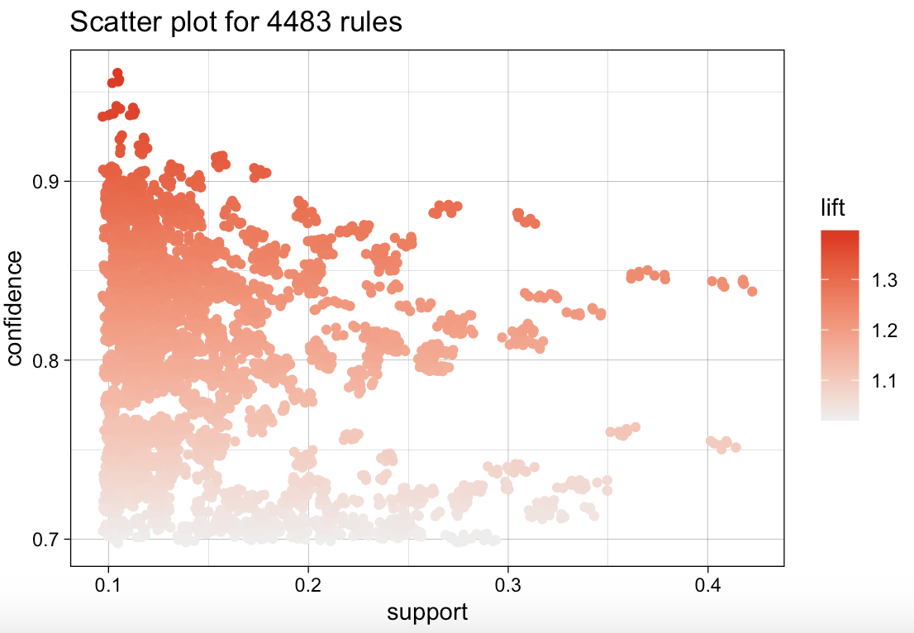
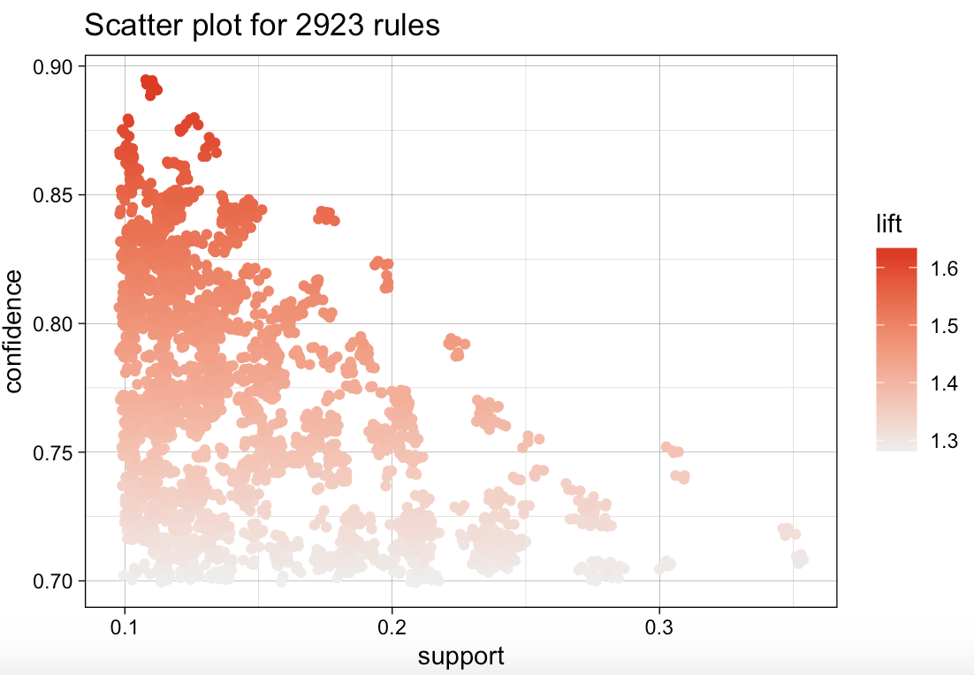
Association rule
Rules | Support | Confidence | Lift
{Income=median, FishProducts=no, Complain=no} => {max_spent=Wines} | 0.1033394 | 0.9581590 | 1.396895
{Income=median, GoldProds=yes, max_spent=Wines, purchase_media=Web, web_visits=more-likely} => {deals=prefer} | 0.1096570 | 0.8933824 | 1.633445

Slide 19

HElp Our client Act NOW
To promote new arrival and selected wines for customers who
Has median income
Does not buy fish products
Does not complain
Provide digital coupons can could be used on online sale platforms for customer who
Buy gold products
Spent the max on wine
Prefer purchase method as web
Visit our client’s website more often

Slide 20

THANK You

